Slide 1
Distributed Systems
ARCHITECTURES

Slide 2
Architectural Styles
One of the major disadvantages of distributed systems is the complexity of the underlying hardware and software arrangements.
This arrangement is generally known as a topology or an overlay.
This is what provides the platform for distributed nodes to communicate and coordinate with each other as needed.

Slide 3
Architectural Styles
Distributed system architectures are bundled up with components and connectors.
Components can be individual nodes or important components in the architecture whereas connectors are the ones that connect each of these components.

Slide 4
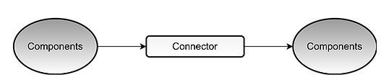
Architectural Styles
Component: A modular unit with well-defined interfaces; replaceable; reusable
Connector: A communication link between modules which mediates coordination or cooperation among components.
distributed architectures should have these components presented on different platforms, where components can communicate with each other over a communication network in order to achieve specifics objectives.

Slide 5
Architectural Styles
There are four different architectural styles, plus the hybrid architecture, when it comes to distributed systems. The basic idea is to organize logically different components, and distribute those computers over the various machines.
Layered Architecture
Object Based Architecture
Data-centered Architecture
Event Based Architecture
Hybrid Architecture

Slide 6
Layered architectures
The layered architecture separates layers of components from each other, giving it a much more modular approach.
A well known example for this is the OSI model that incorporates a layered architecture when interacting with each of the components.
Each interaction is sequential where a layer will contact the adjacent layer and this process continues, until the request is been catered to.
The layers on the bottom provide a service to the layers on the top. The request flows from top to bottom, whereas the response is sent from bottom to top.

Slide 7
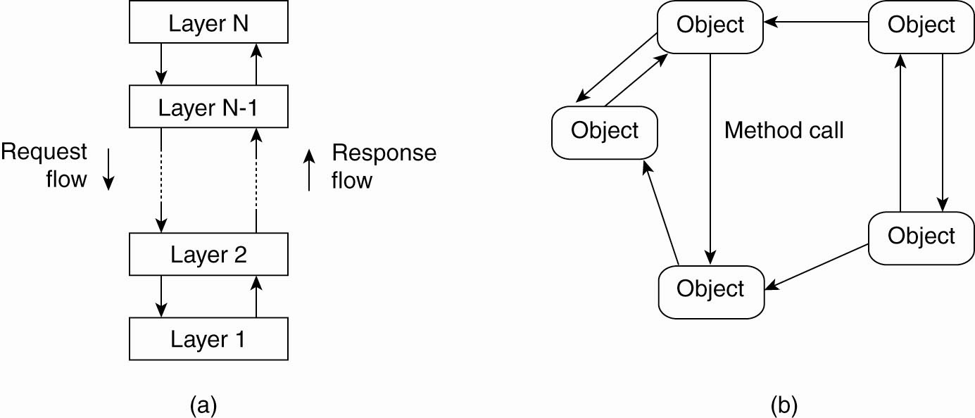
Layered architectures
The layered architectural style

Slide 8
Layered architectures
Advantages:
the calls always follow a predefined path, and that each layer can be easily replaced or modified without affecting the entire architecture.

Slide 9
Object-based architectures
This architecture style is based on loosely coupled arrangement of objects.
This has no specific architecture like layers. Like in layers, this does not have a sequential set of steps that needs to be carried out for a given call.
Each of the components are referred to as objects, where each object can interact with other objects through a given connector or interface.
These are much more direct where all the different components can interact directly with other components through a direct method call.
communication between object happen as method invocations. These are generally called Remote Procedure Calls (RPC). examples are Java RMI, Web Services and REST API Calls.

Slide 10
Object-based architectures
The object-based architectural style.

Slide 11
Object-based architectures
This architecture style is less structured.
component = object
connector = RPC or RMI
When decoupling these processes in space, people wanted the components to be anonymous and replaceable. And the synchronization process needed to be asynchronous, which has led to Data Centered Architectures and Event Based Architectures.

Slide 12
Data-centered architectures
This architecture is based on a data center, where the primary communication happens via a central data repository.
This common repository can be either active or passive.
This common repository, could even be a simple database.
the communication between objects happening through this shared common storage. This supports different components by providing a persistent storage space for those components
All the information related to the nodes in the system are stored in this persistent storage

Slide 13
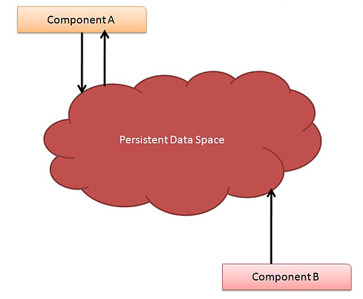
Data-centered architectures

Slide 14
Event-based architectures
The entire communication in this kind of a system happens through events.
When an event is generated, it will be sent to the bus system. With this, everyone else will be notified telling that such an event has occurred.
So, if anyone is interested, that node can pull the event from the bus and use it. Sometimes these events could be data, or even URLs to resources.
So the receiver can access whatever the information is given in the event and process accordingly.
processes communicate through the propagation of events.
These events occasionally carry data

Slide 15
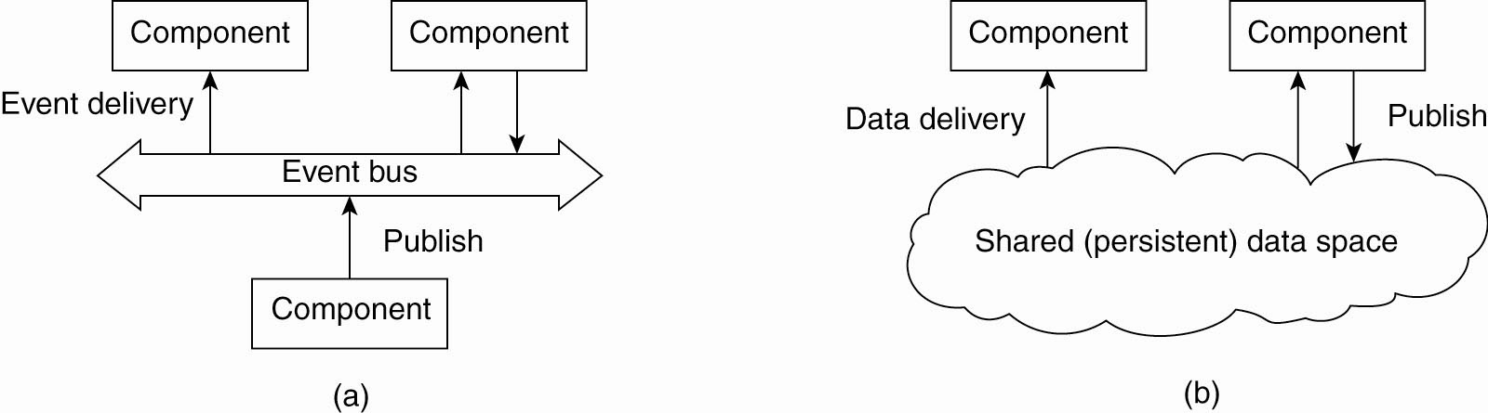
Event-based architectures
Figure 2-2. (a) The event-based architectural style and …

Slide 16
Event-based architectures
Advantages:
this architectural style is that, components are loosely coupled. So it is easy to add, remove and modify components in the system. Some examples are, publisher - subscriber system, Enterprise Services Bus (ESB)
One major advantage is that, these heterogeneous components can contact the bus, through any communication protocol. But an ESB or a specific bus, has the capability to handle any type of incoming request and process accordingly.

Slide 17
Shared data space architectures
Event-based architectures can be combined with data-centered architectures known as shared data spaces.
In shared data spaces the processes are decoupled in time: they need not both be active when communication takes place.

Slide 18
Shared data space architectures
Figure 2-2. (b) The shared data-space architectural style.

Slide 19
System Architectures
How - distributed systems are actually organized by considering where software components are placed
Deciding on software components, their
interaction- s/w architecture or System architecture.
  Centralized organizations
  De centralized organizations
Tanenbaum & Van Steen, Distributed Systems: Principles and Paradigms, 2e, (c) 2007 Prentice-Hall, Inc. All rights reserved. 0-13-239227-5

Slide 20
Centralized Architectures
In the basic client-server model, processes in a distributed system are divided into two groups.
A server is a process implementing a specific service.
A client is a process that requests a service from a server by sending it a request and waiting for the server's reply.
Also known as request-reply behavior

Slide 21
Centralized Architectures
Advantages:
Easier to Build and Maintain
Better Security
Stable
Disadvantages:
Single point of failure
Less scalable

Slide 22
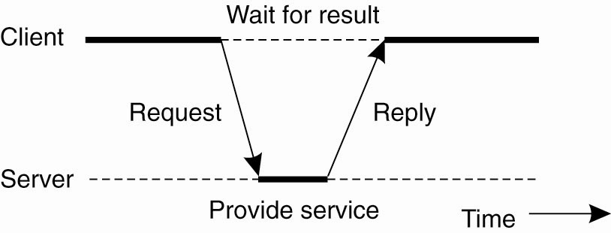
Centralized Architectures
Figure 2-3. General interaction between a client and a server.

Slide 23
Centralized Architectures
Communication between a client and a server can be implemented by means of connectionless protocol when the underlying network is reliable
when a client requests a service, it packages a message for the server, identifying the service it wants, along with the necessary input data.
The message is then sent to the server.
wait for an incoming request, subsequently process it, and package the results in a reply message that is then sent to the client.

Slide 24
Centralized Architectures
Many client-server systems use a reliable connection oriented protocol.
This solution is not entirely appropriate in a local-area network due to relatively low performance but works perfectly fine in wide-area systems in which communication is inherently unreliable.

Slide 25
Application Layering
Layers of architectural style
The user-interface level
The processing level
The data level

Slide 26
The user-interface level
The user-interface level: contains all that is necessary to directly interface with the user.
Clients implement the user-interface level.
This level consists of the programs that allow end users to interact with applications

Slide 27
The processing level
Contains the applications.
Many client-server applications can be constructed from different pieces
handles interaction with a user
operates on a database or file system
middle part that contains the core functionality
of an application. This middle part is logically placed at the processing level

Slide 28
The data level
The data level: manages the actual data that is being acted on.
An important property of this level is that data are often persistent i.e even if no application is running, data will be stored somewhere for next use
Data level is generally responsible for
keeping data consistent across different applications

Slide 29
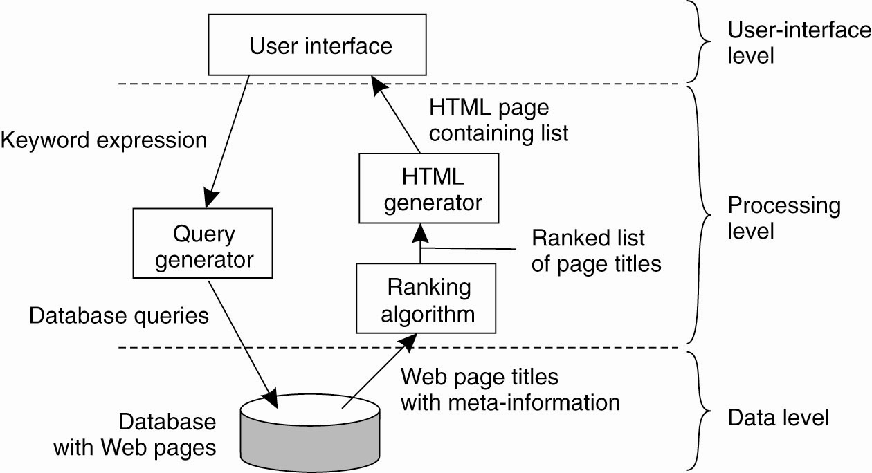
Application Layering
Figure 2-4. The simplified organization of an Internet search engine into three different layers.

Slide 30
Multi tiered Architectures
The simplest organization is to have only two types of machines:
A client machine containing only the programs implementing the user-interface level
A server machine containing the rest
  the programs implementing the processing and data level

Slide 31
Multi tiered Architectures
Multi tiered client-server architectures are a direct consequence of dividing applications into a user-interface, processing components, and a data level.
The different tiers correspond directly with the logical organization of applications

Slide 32
Multi tiered Architectures
other possibilities:
Distribute the programs in the application layers of the previous section across different machines.
To have only the terminal-dependent part of the user interface on the client machine and give the applications remote control over the presentation of their data Fig. 2-5(a)

Slide 33
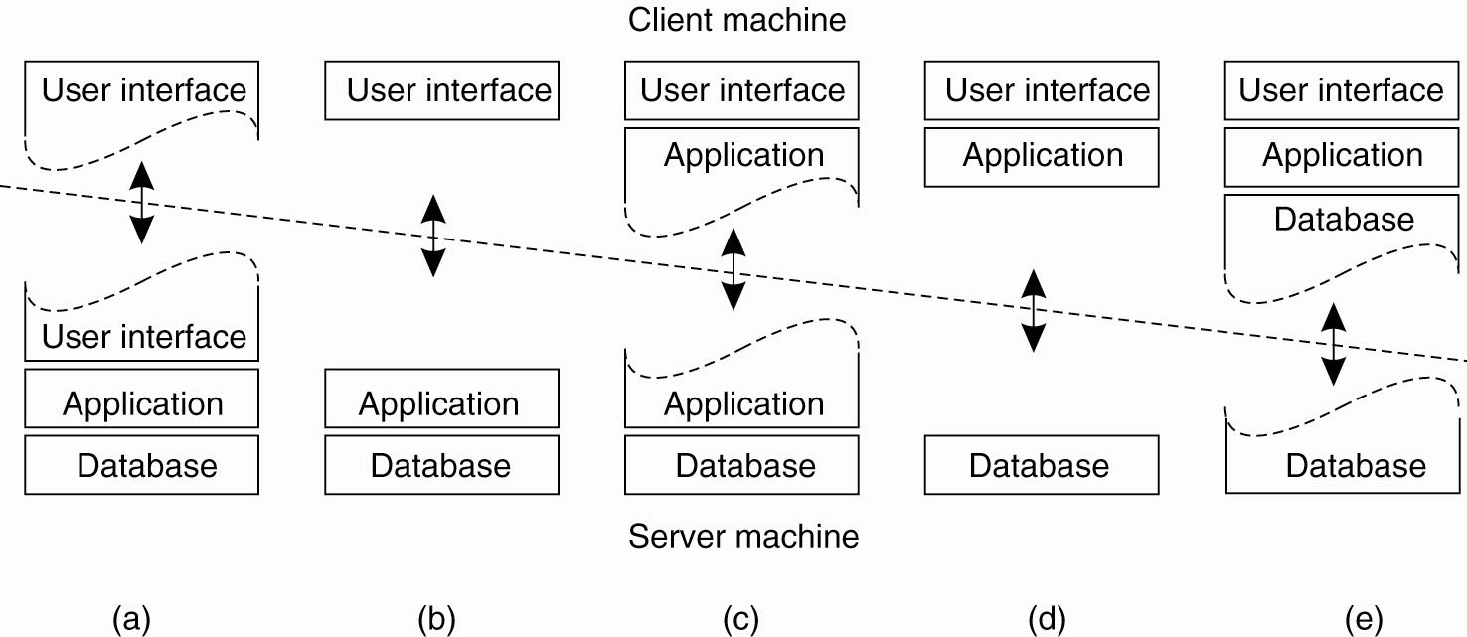
Multi tiered Architectures
Figure 2-5. Alternative client-server organizations (a)–(e).

Slide 34
Multi tiered Architectures
other possibilities:
To place the entire user-interface software on the client side, essentially divide the application into a graphical front end, which
communicates with the rest of the aplication through an application-specific protocol
In this model, the front end does no processing other than necessary for presenting the application's interface-
Fig 2.5(b)

Slide 35
Multi tiered Architectures
other possibilities:
move part of the application to the front end.
The front end can then check correctness and consistency of the form, and where necessary interact with the user Fig. 2-5(c)
The client machine is a PC or workstation, connected through a network to a distributed
file system or database
most of the application is running on the client machine, but all operations on files or database entries go to the server

Slide 36
Multi tiered Architectures
Three tired Architecture
programs that form part of the processing level reside on a separate server, but may additionally be partly distributed across the client and server machines.

Slide 37
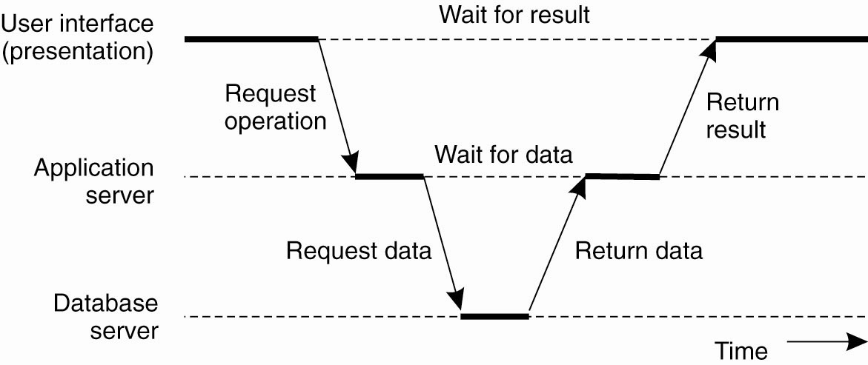
Multi tiered Architectures
Figure 2-6. An example of a server acting as client.

Slide 38
Decentralized Architectures
In these architectures there is no central control in a distributed system.
Each node can either be a client or a server at a given time.
If the node is requesting something, it can be known as a client, and if some node is providing something, it can be known as a server.
In general, each node is referred to as a Peer.

Slide 39
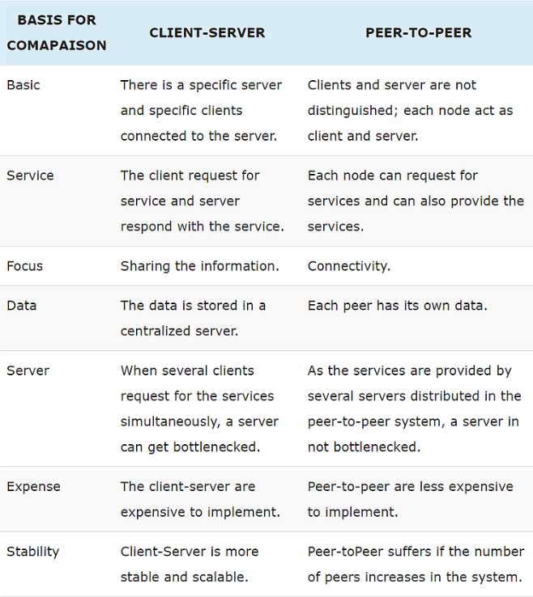
Comparision

Slide 40
Decentralized Architectures
Structured Peer-to-Peer Architectures
Unstructured Peer-to-Peer Architectures

Slide 41
Structured Peer-to-Peer Architectures
In this architecture, the system already has a predefined structure that other nodes will follow.
Every structured network inherently suffers from poor scalability, due to the need for structure maintenance.
In general, the nodes in a structured overlay network are formed in a logical ring, with nodes being connected to the this ring.
In this ring, certain nodes are responsible for certain services.
A common approach that can be used to tackle the coordination between nodes, is to use distributed hash tables (DHTs).
A traditional hash function converts a unique key into a hash value, that will represent an object in the network.
The hash function value is used to insert an object in the hash table and to retrieve it.

Slide 42
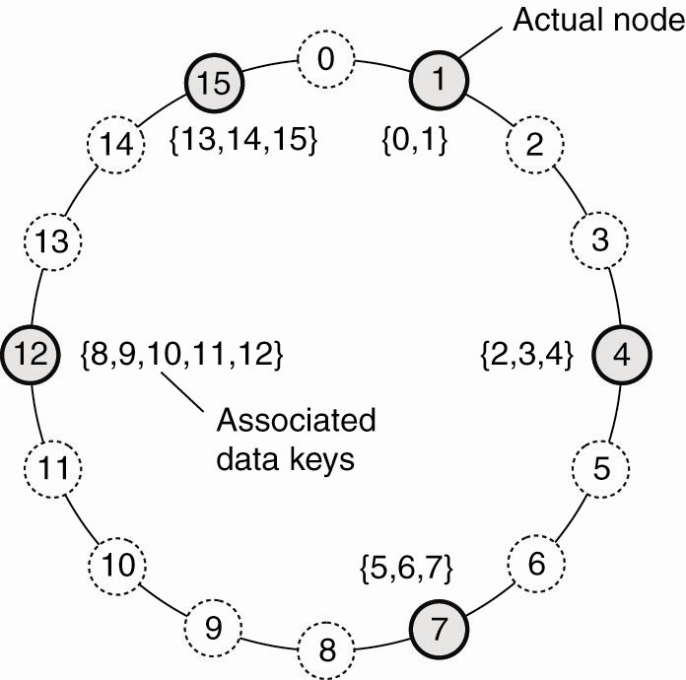
Structured Peer-to-Peer Architectures (1)
Figure 2-7. The mapping of data items onto nodes in Chord.

Slide 43
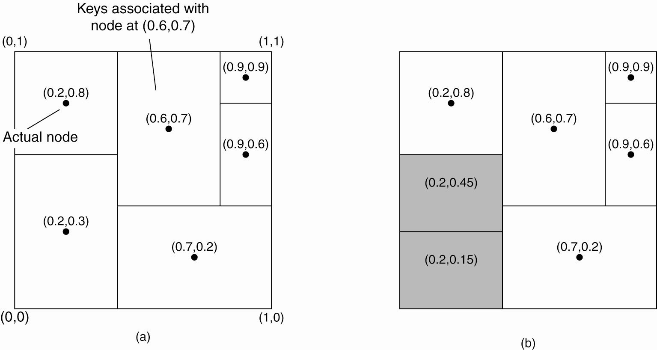
Structured Peer-to-Peer Architectures (2)
Figure 2-8. (a) The mapping of data items onto nodes in CAN.

Slide 44
Structured Peer-to-Peer Architectures (3)
Figure 2-8. (b) Splitting a region when a node joins.

Slide 45
Structured Peer-to-Peer Architectures
In a DHT, each key is assigned to a unique hash, where the random hash value needs to be of a very large address space, in order to ensure uniqueness.
A mapping function is being used to assign objects to nodes based on the hash function value.
A look up based on the hash function value, returns the network address of the node that stores the requested object.
Hash Function: Takes a key and produces a unique hash value
Mapping Function: Map the hash value to a specific node in the system
Lookup table: Return the network address of the node represented by the unique hash value.

Slide 46
Unstructured Peer-to-Peer Architectures
These systems largely rely on randomized algorithms for constructing an overlay network.
The main idea is that each node maintains a list of neighbors, but this list is constructed in a random way.
Data items are assumed to be randomly placed on nodes.
when a node needs to locate a specific data item flood the network with a search queue.
One of the goals of many unstructured peer-to-peer systems is to construct an overlay network that resembles a random graph.
The basic model is that each node maintains a list of c neighbors

Slide 47
Topology Management of Overlay Networks
Topology management is achieved by adopting a two layered approach
The lowest layer constitutes an unstructured peer-to-peer system in which nodes periodically exchange entries of their partial views with the aim to maintain an accurate random graph.
The lowest layer passes its partial view to the higher layer, where an additional selection of entries takes place.
This then leads to a second list of neighbors corresponding to the desired topology

Slide 48
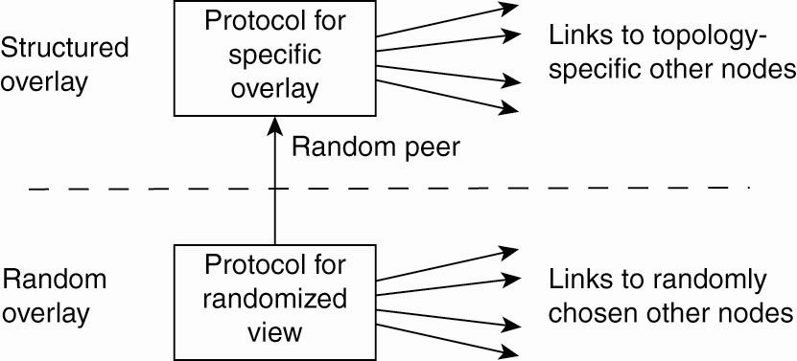
Topology Management of Overlay Networks (1)
Figure 2-10. A two-layered approach for constructing and maintaining specific overlay topologies using techniques from unstructured peer-to-peer systems.

Slide 49
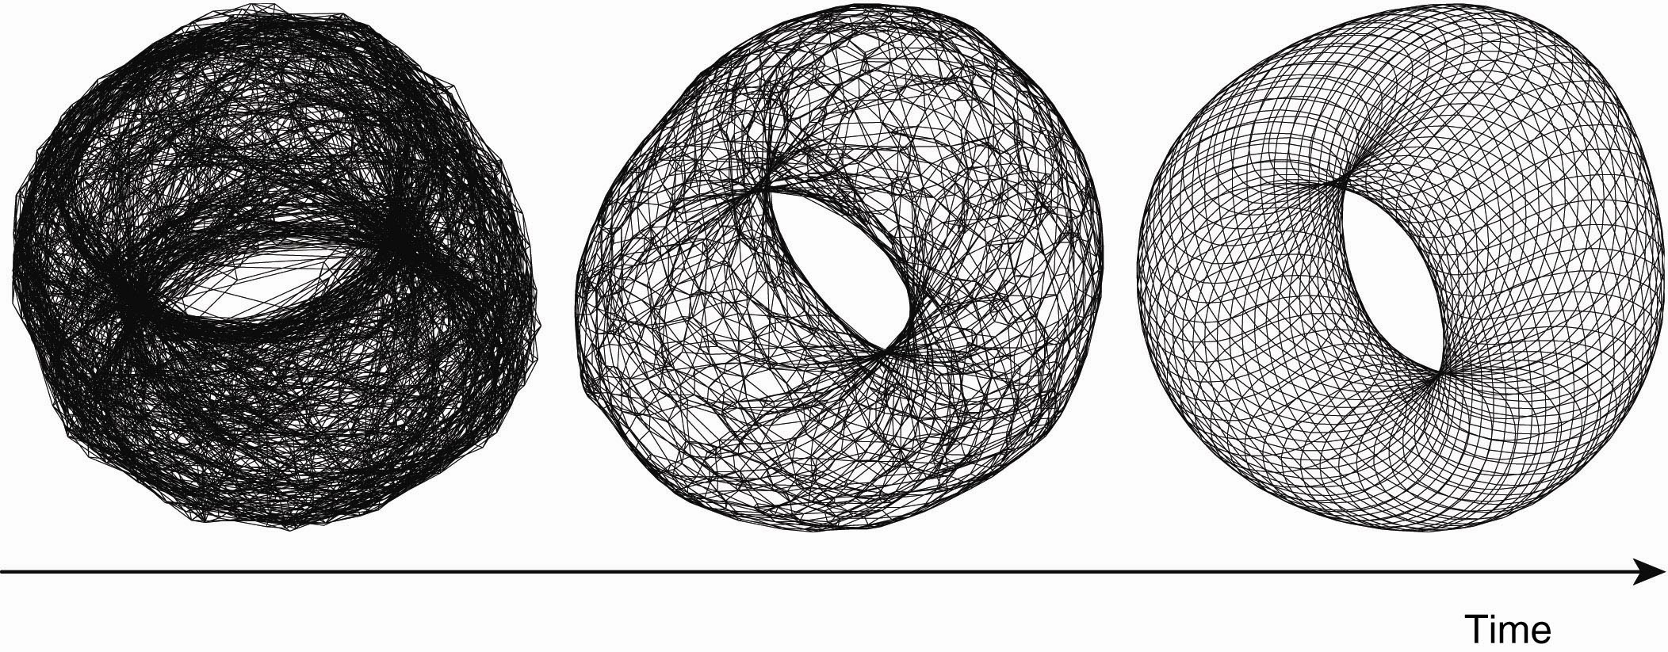
Topology Management of Overlay Networks (2)
Figure 2-11. Generating a specific overlay network using a two-layered unstructured peer-to-peer system [adapted with permission from Jelasity and Babaoglu (2005)].

Slide 50
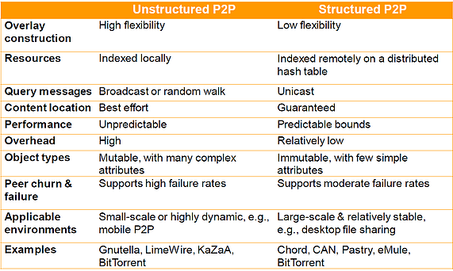
Comparision

Slide 51
Superpeers
Nodes those maintaining an index referred to as superpeers.
Superpeers are often organized in a peer-to-peer network, leading to a hierarchical organization
In this organization, every regular peer is connected
as a client to a superpeer. All communication from and to a regular peer proceeds through that peer's associated superpeer
Generally the client-superpeer relation is fixed whenever a regular peer joins the network, it attaches to one of the superpeers and remains attached until it leaves the network.

Slide 52
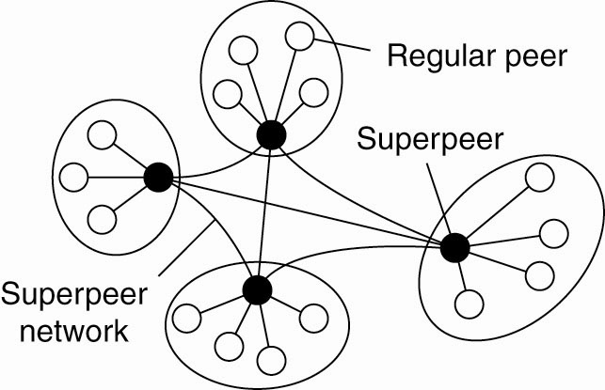
Superpeers
Figure 2-12. A hierarchical organization of nodes into a
superpeer network.

Slide 53
Hybrid Architectures
Many distributed systems combine architectural features of distributed systems in which client-server solutions with decentralized architectures

Slide 54
Edge-Server Systems
An important class of distributed systems that is organized according to a hybrid architecture is formed by edge-server systems.
These systems are deployed on the Internet where servers are placed "at the edge" of the network.
This edge is formed by the boundary between enterprise networks and the actual Internet.
End users at home connect to the Internet through their ISP, the ISP can be considered as residing at the edge of the Internet.
The edge server's main purpose is to serve content
Collection of edge servers can be used to optimize content and application distribution

Slide 55
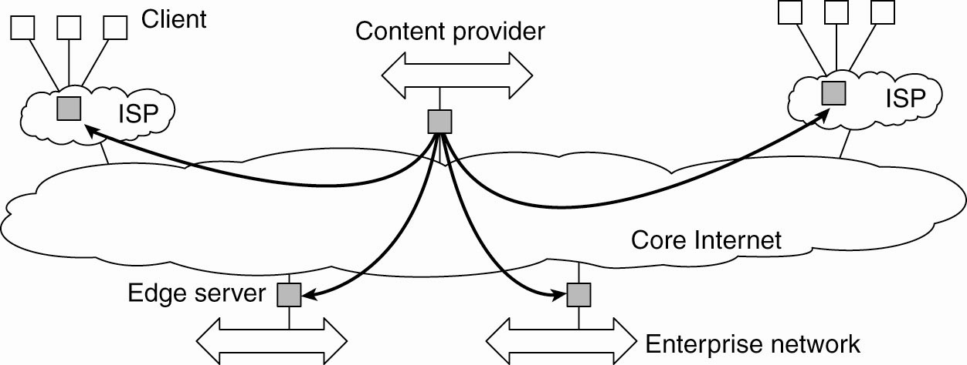
Edge-Server Systems
Figure 2-13. Viewing the Internet as consisting of a
collection of edge servers.

Slide 56
Collaborative Distributed Systems
Hybrid structures are deployed in collaborative distributed systems.
The main issue in many of these systems to first get started, for which often a traditional client-server scheme is deployed.
Once a node has joined the system, it can use a fully decentralized scheme for collaboration.
Ex: BitTorrent and Globule systems
BitTorrent combines centralized with decentralized solutions.
The bottleneck of the system is formed by the trackers in BitTorrent

Slide 57
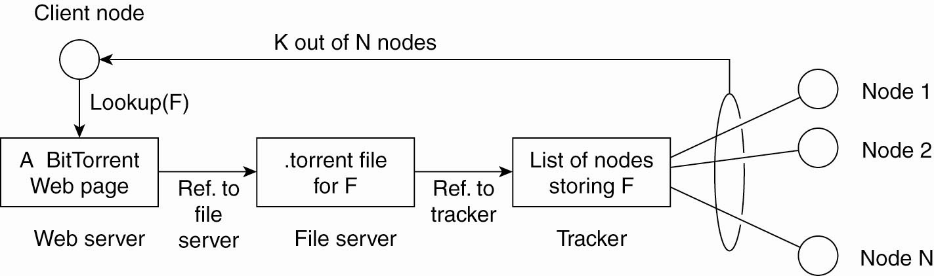
Collaborative Distributed Systems
Figure 2-14. The principal working of BitTorrent [adapted with permission from Pouwelse et al. (2004)].

Slide 58
Collaborative Distributed Systems
Globule resembles the edge server architecture
But instead of edge servers, end users voluntarily provide enhanced Web servers that are capable of collaborating in the replication of Web pages.
Each such server has the following components:
A component that can redirect client requests to other servers.
A component for analyzing access patterns.
A component for managing the replication of Web pages.

Slide 59
ARCHITECTURES VERSUS MIDDLEWARE
When considering the architectural issues a question
that comes is where middleware fits in
Middleware forms a layer between applications and distributed platforms.
An important purpose is to provide a degree of distribution transparency: hiding the distribution of-data, processing, and control from applications.

Slide 60
ARCHITECTURES VERSUS MIDDLEWARE
Middleware systems actually follow a specific architectural style
Having middleware molded according to a specific architectural style has the benefit that designing applications may become simpler.
But the drawback is that the middleware may no longer be optimal for what an application developer had in mind and specific solutions should be adaptable to application requirements.

Slide 61
ARCHITECTURES VERSUS MIDDLEWARE
One solution to this problem is to make several versions of a middleware system, where each version is tailored to a specific class of applications.
Better approach is to make middleware systems
such that they are easy to configure, adapt, and customize as needed by an application.
This has led to several mechanisms by which the behavior of middleware can be modified

Slide 62
Interceptors
An interceptor is a software construct that will break the usual flow of control and allow other application specific code to be executed.
To make interceptors generic may require a substantial implementation effort and it is unclear whether in such cases generality should be preferred over restricted applicability and simplicity.
Also, in many cases having only limited interception facilities will improve management of the software and the distributed system as a whole.

Slide 63
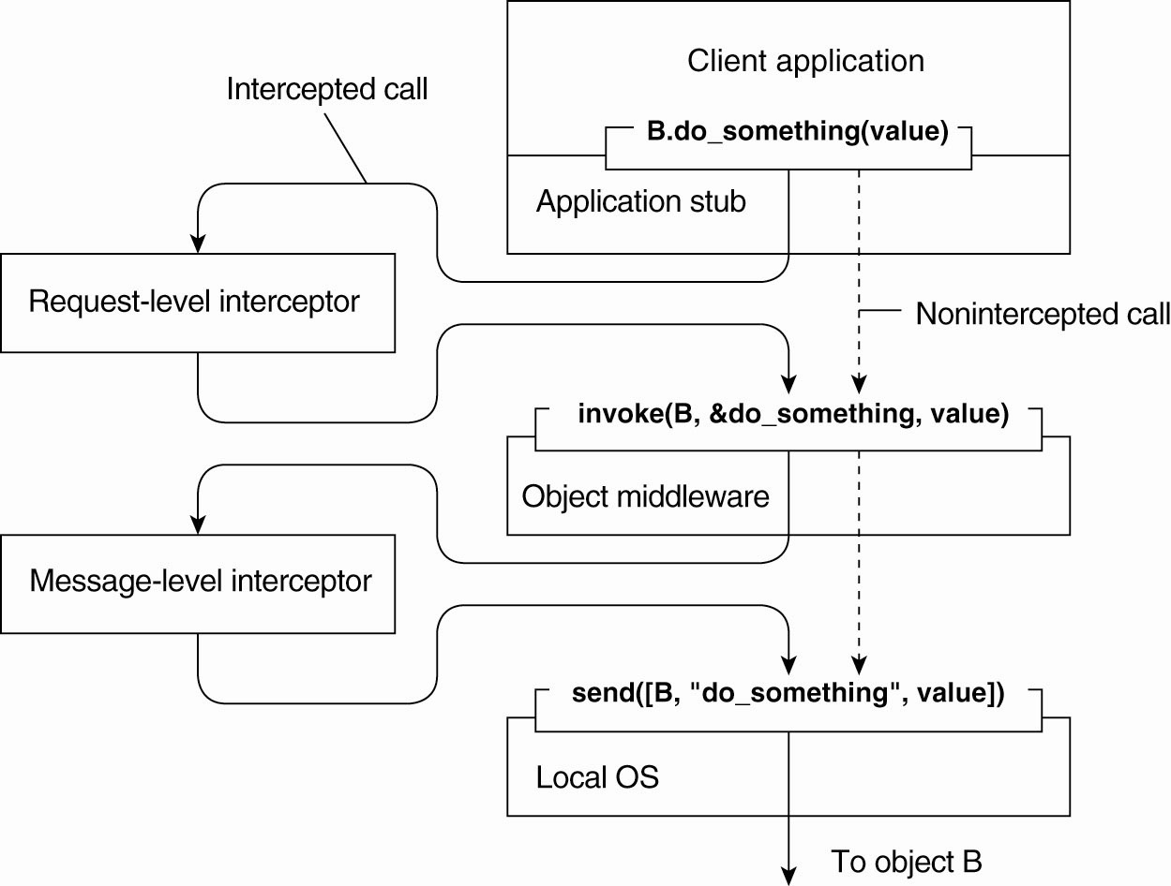
Interceptors
Figure 2-15. Using interceptors to handle
remote-object invocations.

Slide 64
General Approaches to Adaptive Software
Interceptors offer is a means to adapt the middleware.
The need for adaptation comes from the fact that the environment in which distributed applications are executed changes continuously.
Changes include those resulting from mobility, a strong variance in the quality-of-service of networks, failing,
hardware, and battery drainage, amongst others.
Rather than making applications responsible for reacting to changes, this task is placed in the middleware.

Slide 65
General Approaches to Adaptive Software
Three basic approaches to adaptive software:
Separation of concerns
Computational reflection
Component-based design

Slide 66
Separation of concerns
Separate the parts that implement functionality from those that take care of other things such as reliability, performance, security etc.
The main problem is that we cannot easily separate these extra functionalities by means of modularization

Slide 67
Computational reflection
Computational reflection refers to the ability of a program to inspect itself and, if necessary, adapt its behavior

Slide 68
Component-based design
Component-based design supports adaptation through composition.
A system may either be configured statically at design time, or dynamically at runtime.

